Slide 1
Welcome!
Question of the Day:
‹#›

Slide 2
7.6 Arrays of Pixels
PROFESSOR RAMSEY
GDC 6.318
ramsey@cs.utexas.edu

Slide 3
Announcements
TBD

Slide 4
Unit 2 Test Info
The test focuses on Chapters 3G - 7. Understanding of material previously covered in Chapters 1 - 3 is necessary, but not the focus.
* There is an extra time test and a make-up test for students who have been approved ahead of time. There is also an alternate test time for students with a UT testing conflict and who have been approved ahead of time. The day, time and location of these tests will be emailed to the approved students.

Slide 5
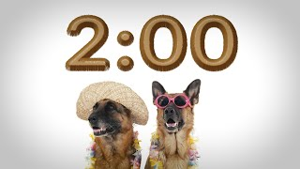
Quiz

Slide 6
6.6
Arrays of Pixels

Slide 7
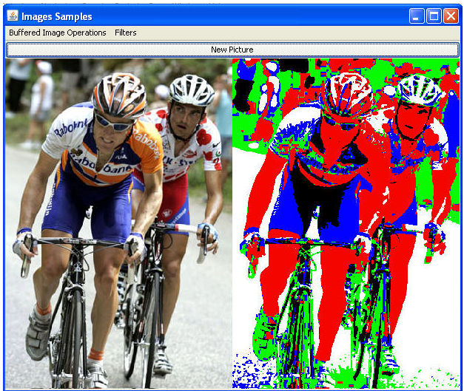
Graphics Example - Photo Manipulation
‹#›

Slide 8
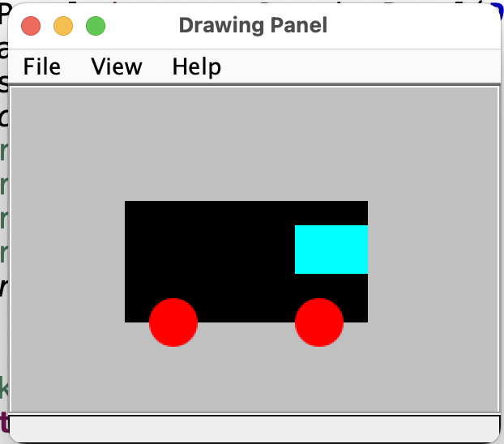
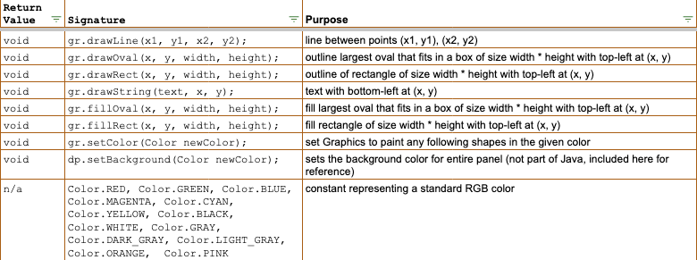
Remember Graphics?

Slide 9
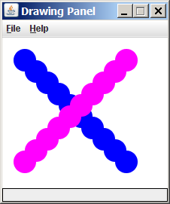
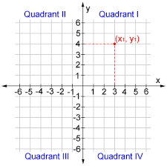
Java Drawing Panel
Like this quadrant, but flipped.
x =====>
(x,y)
(0,0) (300,0)
y
(0,500) (300,500)
=====>
‹#›

Slide 10
Java Drawing Options
x =====>
(x,y)
(0,0) (800,0)
y
(0,500) (800,500)
drawLine()
drawRect()
Indicates
x, y location
drawOval()
=====>
fillRect()
filOval()
drawString()
‹#›

Slide 11
Demo
MovingTruck.java
Review

Slide 12
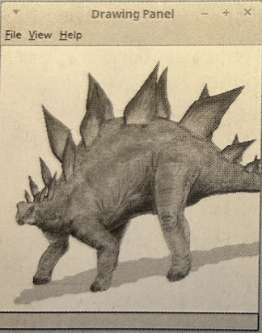
What if?
The ovals, rectangles, lines and text provided by the Graphics object are very limiting. What if we could modify each pixel? Think of what we could do!

Slide 13
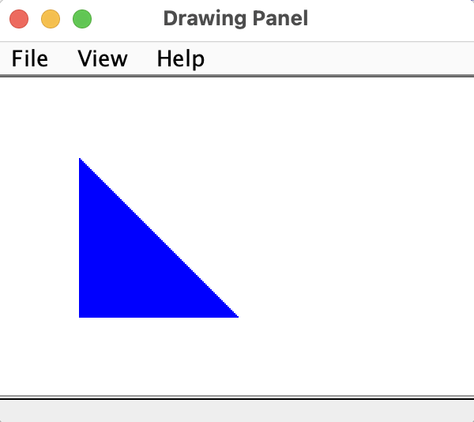
Arrays of Pixels
x =====>
(x,y)
(0,0) (300,0)
y
(0,200) (300,200)
But, there is no drawTriangle()!
Treat the canvas like a 2D array of pixels. Assign each pixel a color.
=====>

Slide 14
Blue Triangle Design
300, 200 panel
Still rows and columns
Remember [y][x] for the 2D pixels array.
outside loop once per row, from 50 to 150.
inside loop once per col, from 50 to current row
(50, 50)
(150, 50) (150, 150)

Slide 15
NEW Drawing Panel Methods
Returns a 2D array of Colors, representing the color of each pixel on the drawing panel:
Color[][] pixels = dp.getPixels()
Changes the color of one pixel:
pixels[10][20] = Color.BLUE;
Updates the drawing panel with new pixel colors:
dp.setPixels(pixels);

Slide 16
Demo
Demo 1
Write drawBlueTriangle().

Slide 17
Design

Slide 18
Solution

Slide 19
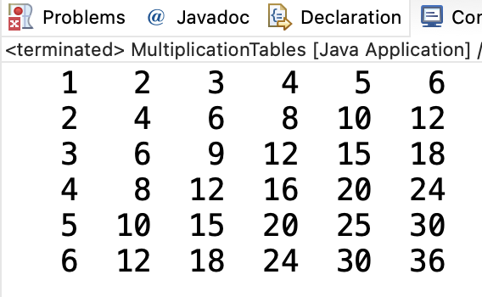
Important Difference
Two perspectives:
DrawingPanel, based on coordinate plane, x is first [] and horizontal
2D array, based on technical reasons sometimes and natural language, i is first [] and vertical.
2D array of colors is [y][x] based.
Be aware of the difference, use only one perspective in given algorithm.
x =====>
(x,y)
(0,0) (300,0)
y
(0,500) (300,500)
cols (j)
rows (i)
=====>

Slide 20
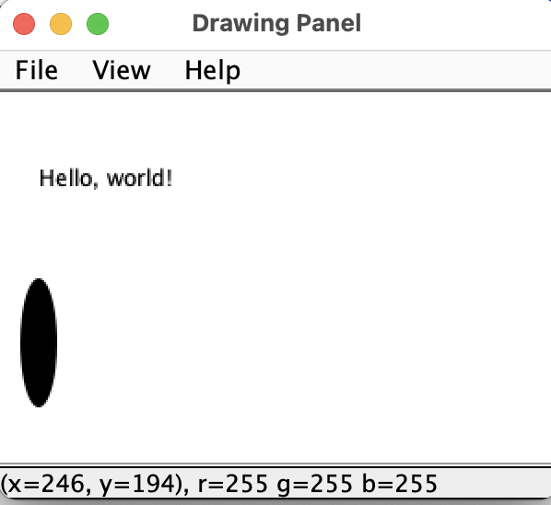
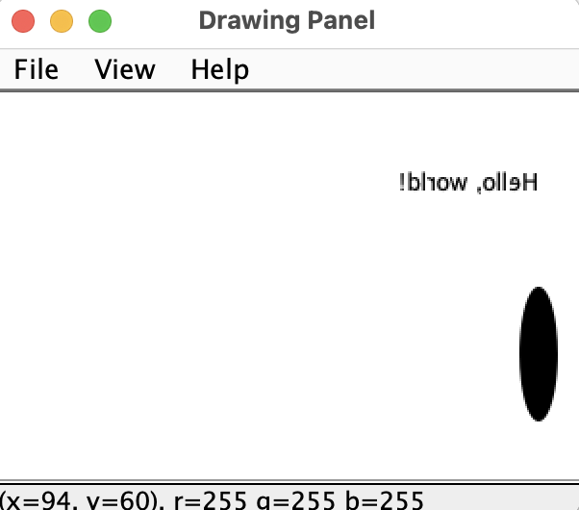
In-Class Practice
Initial Graphic Graphic after mirror()
mirror()
Write mirror() to create a mirror image of an existing graphic. Use this calling code.

Slide 21
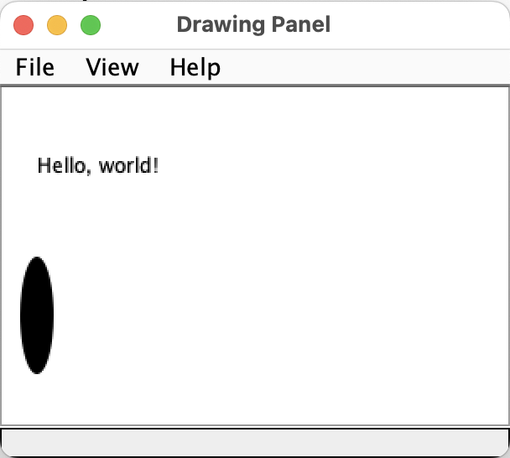
Design
Before:
After:
Loop for each row
Inside that, loop for first half of the columns.
Swap each pixel with its opposite side pixel

Slide 22
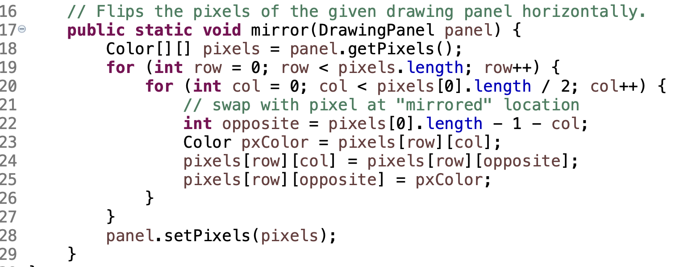
Solution

Slide 23
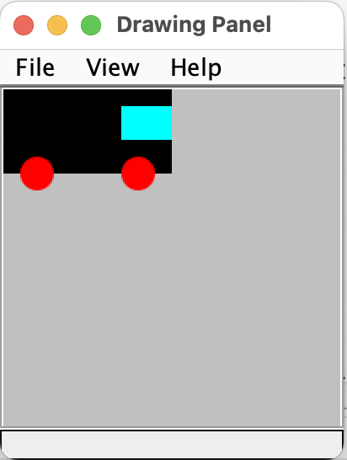
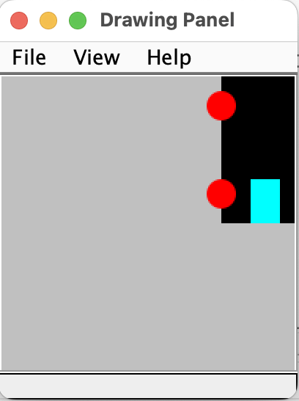
In-Class Practice
Initial Graphic Graphic after rotate90()
rotate90.java
Write rotate90() to create an image rotated 90 degrees to the right. Calling code:

Slide 24
Design

Slide 25
Solution

Slide 26
Remember
You Belong Here
Hi!

